Slide 1


Introduction to Operating Systems CS 1550
Spring 2023
Sherif Khattab
ksm73@pitt.edu
(Some slides are from Silberschatz, Galvin and Gagne ©2013)

Slide 2
Announcements
Upcoming deadlines
Quiz 2 and Homework 8 due this Friday
2 extra attempts for HW 8
Lab 3 is due on Tuesday 3/28 at 11:59 pm
Project 3 is due Friday 4/7 at 11:59 pm

Slide 3
Previous Lecture …
Page replacement algorithms
OPT, NRU, FIFO, Second Chance, CLOCK, LRU, NFU

Slide 4
Aging replacement algorithm
Reduce counter values over time
Divide by two every clock cycle (use right shift)
More weight given to more recent references!
Select page to be evicted by finding the lowest counter value
Algorithm is:
Every clock tick, shift all counters right by 1 bit
On reference, set leftmost bit of a counter (can be done by copying the reference bit to the counter at the clock tick)
Referenced this tick
Tick 0
Tick 1
Tick 2
Tick 3
Tick 4
Page 0
10000000
11000000
11100000
01110000
10111000
Page 1
00000000
10000000
01000000
00100000
00010000
Page 2
10000000
01000000
00100000
10010000
01001000
Page 3
00000000
00000000
00000000
10000000
01000000
Page 4
10000000
01000000
10100000
11010000
01101000
Page 5
10000000
11000000
01100000
10110000
11011000

Slide 5
Working set
Demand paging: bring a page into memory when it’s requested by the process
How many pages are needed?
Could be all of them, but not likely
Instead, processes reference a small set of pages at any given time—locality of reference
Set of pages can be different for different processes or even different times in the running of a single process
Set of pages used by a process in a given interval of time is called the working set
If entire working set is in memory, no page faults!
If insufficient space for working set, thrashing may occur
Goal: keep most of working set in memory to minimize the number of page faults suffered by a process

Slide 6
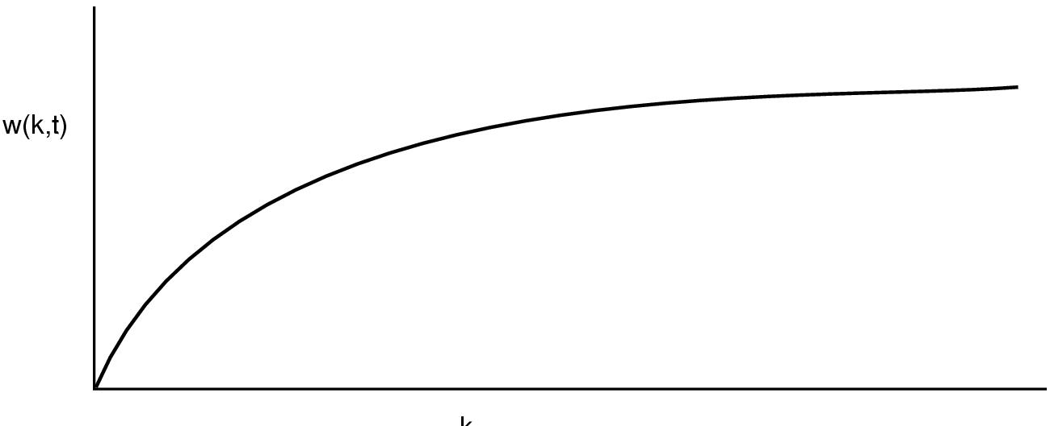
How big is the working set?
w(k,t)
k
Working set is the set of pages used by the k most recent memory references
w(k,t) is the size of the working set at time t
Working set may change over time
Size of working set can change over time as well…

Slide 7
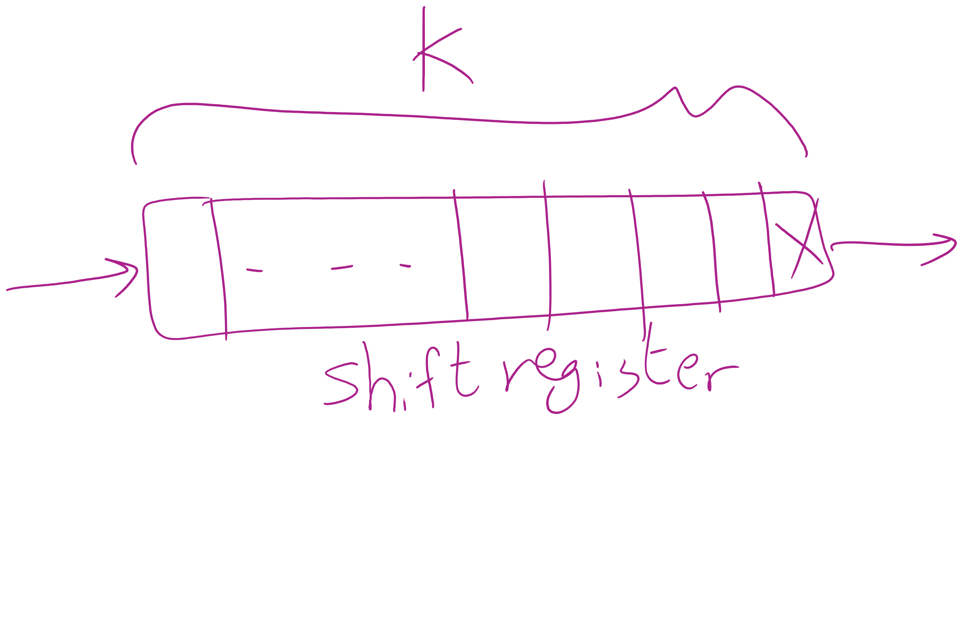
Keeping track of the Working Set

Slide 8
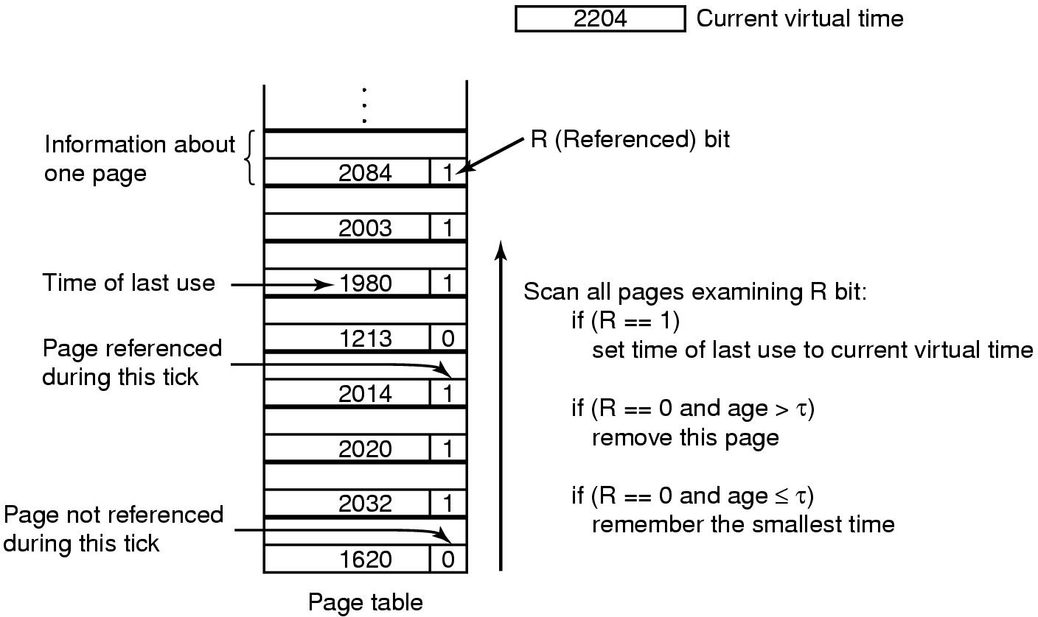
Working set page replacement algorithm

Slide 9
Summary
Page replacement algorithms
Algorithm | Comment
OPT (Optimal) | Not implementable, but useful as a benchmark
NRU (Not Recently Used) | Crude
FIFO (First-In, First Out) | Might throw out useful pages
Second chance | Big improvement over FIFO
Clock | Better implementation of second chance
LRU (Least Recently Used) | Excellent, but hard to implement exactly
NFU (Not Frequently Used) | Poor approximation to LRU
Aging | Good approximation to LRU, efficient to implement
Working Set | Somewhat expensive to implement
WSClock | Implementable version of Working Set

Slide 10
Algorithm Simulation
How to simulate page replacement algorithms
FIFO/Clock
LRU, OPT

Slide 11
How is modeling done?
Generate a list of references
Artificial (made up)
Trace a real workload (set of processes)
Use an array (or other structure) to track the pages in physical memory at any given time
May keep other information per page to help simulate the algorithm (modification time, time when paged in, etc.)
Run through references, applying the replacement algorithm
Example: FIFO replacement on reference string 0 1 2 3 0 1 4 0 1 2 3 4
Page replacements highlighted in yellow
Page referenced |  | 0 | 1 | 2 | 3 | 0 | 1 | 4 | 0 | 1 | 2 | 3 | 4
Youngest page |  | 0 | 1 | 2 | 3 | 0 | 1 | 4 | 4 | 4 | 2 | 3 | 3
 |  |  | 0 | 1 | 2 | 3 | 0 | 1 | 1 | 1 | 4 | 2 | 2
Oldest page |  |  |  | 0 | 1 | 2 | 3 | 0 | 0 | 0 | 1 | 4 | 4

Slide 12
Interactive Simulation Tool
https://sim-50.github.io/cs-tools/

Slide 13
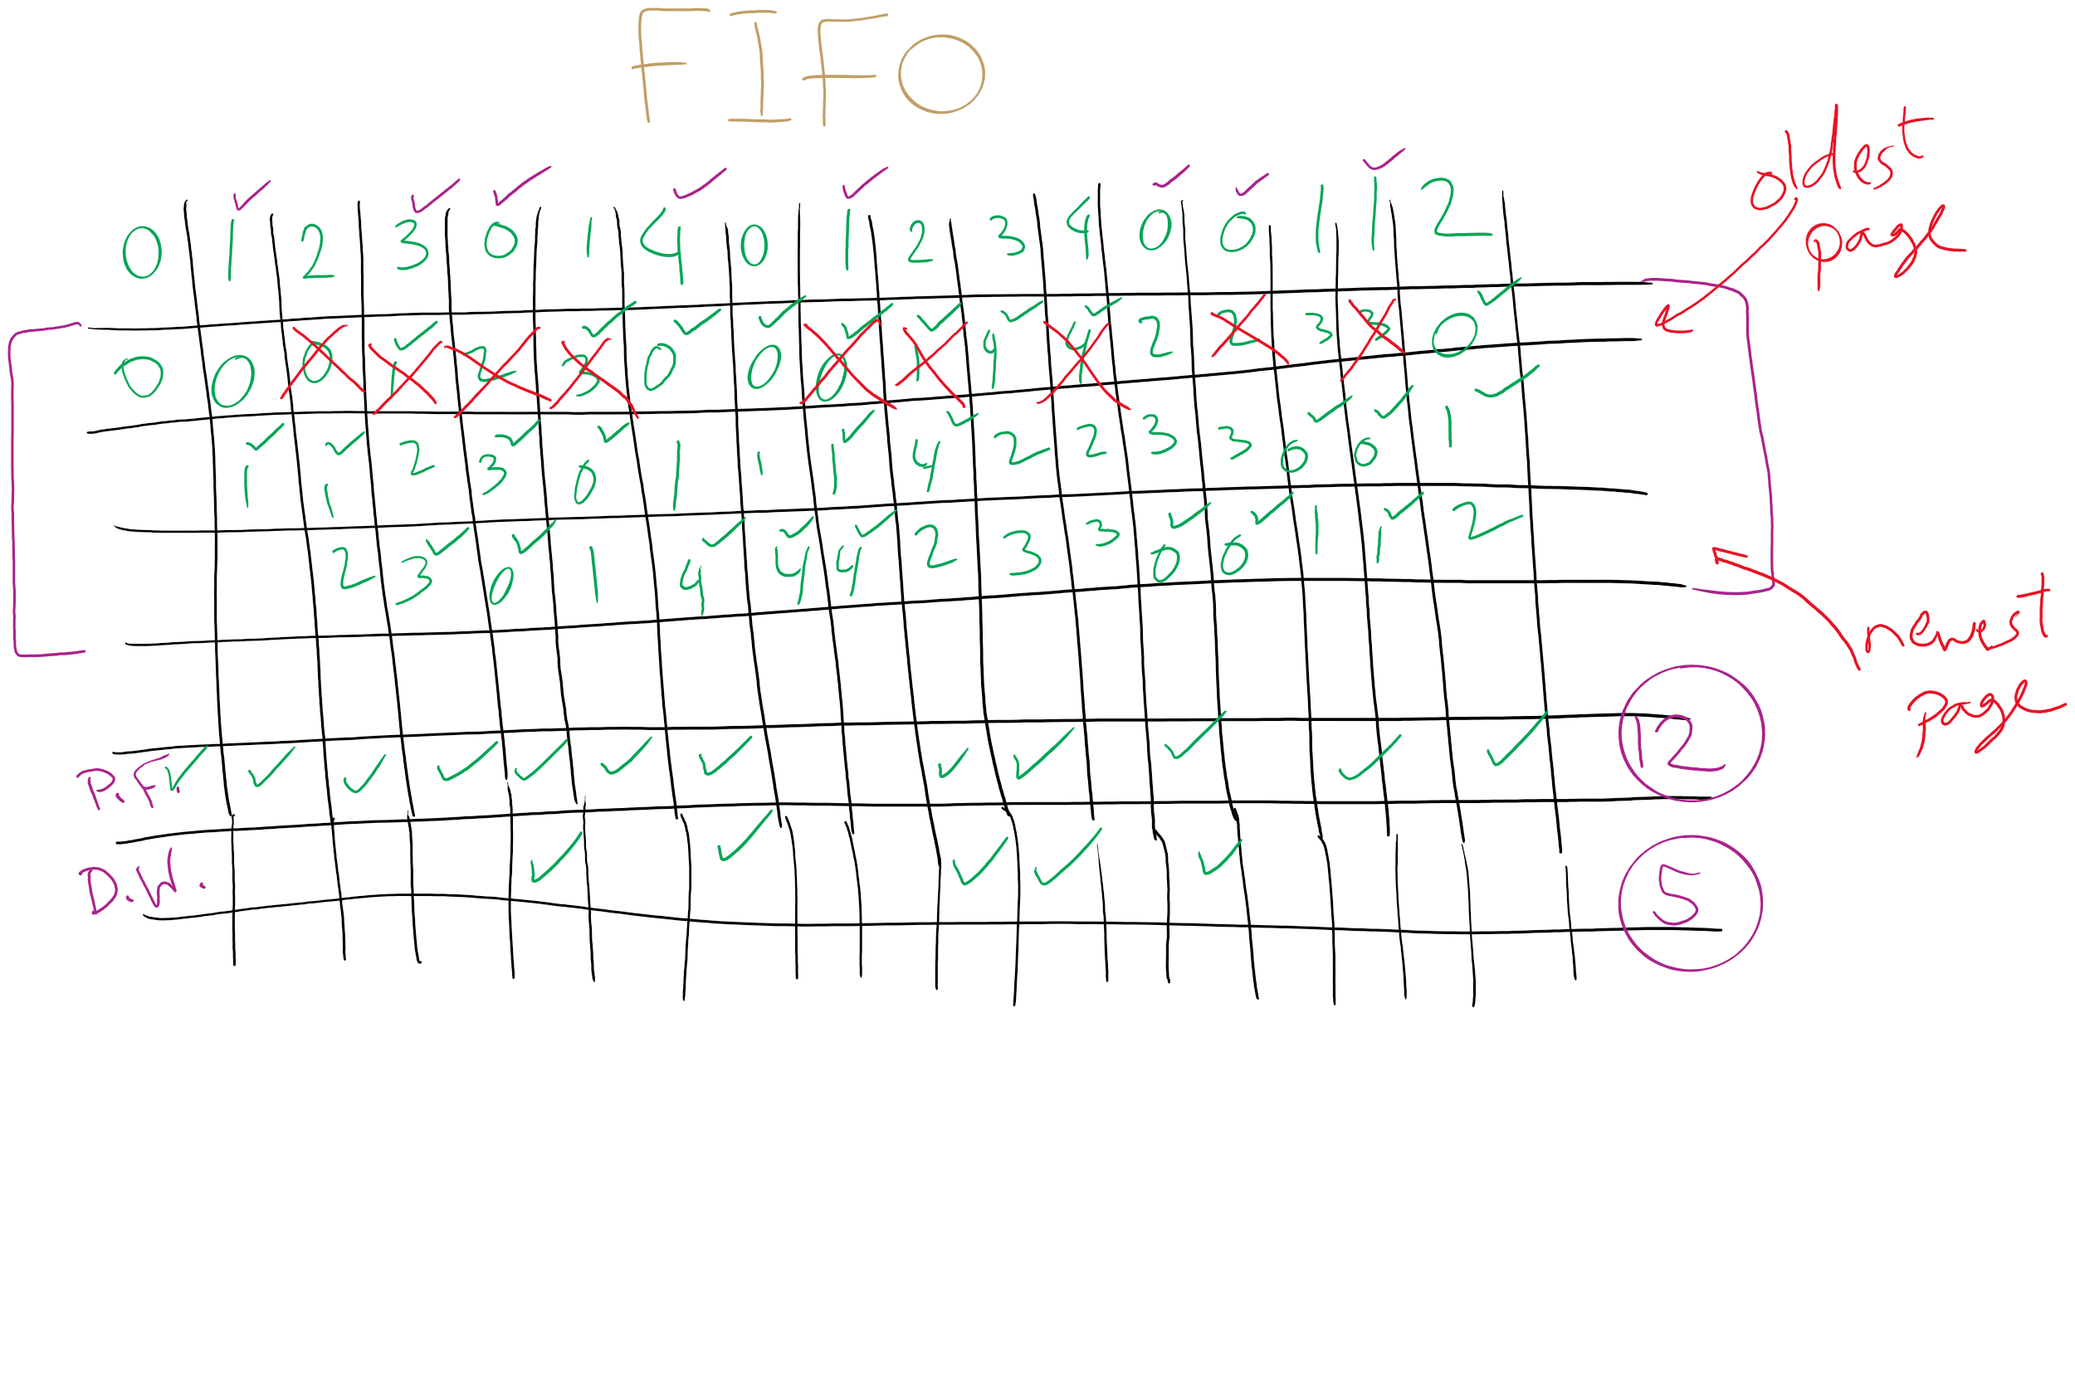
FIFO with 3 frames

Slide 14
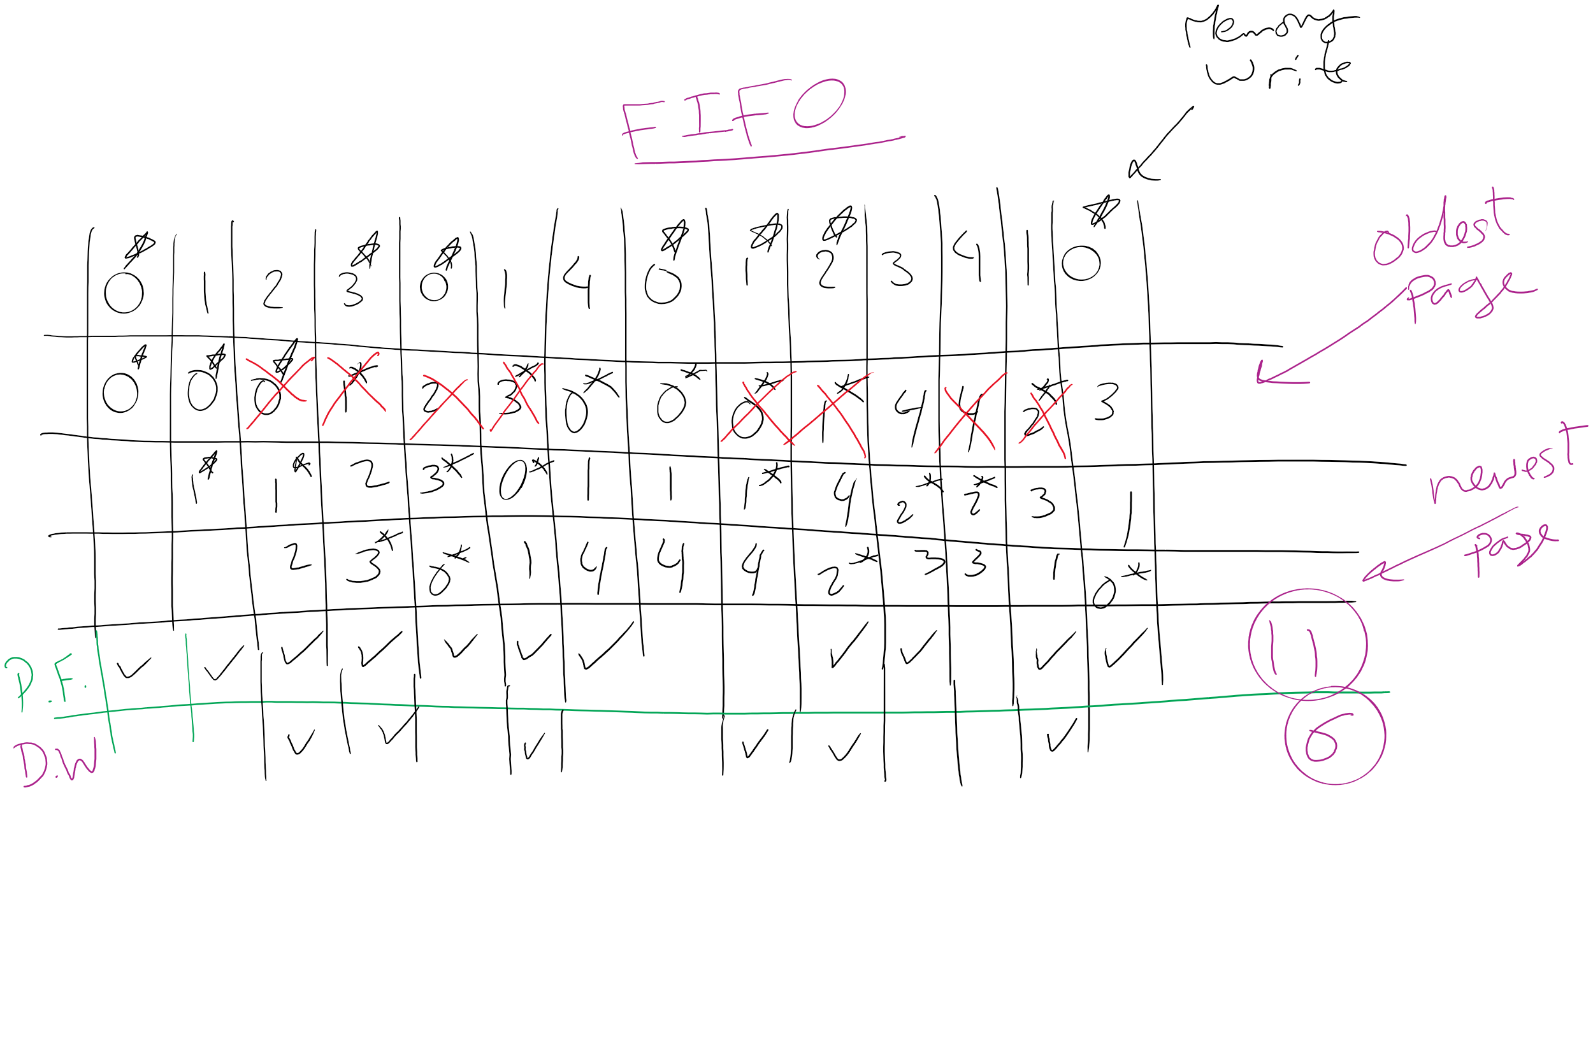
FIFO Example 1

Slide 15
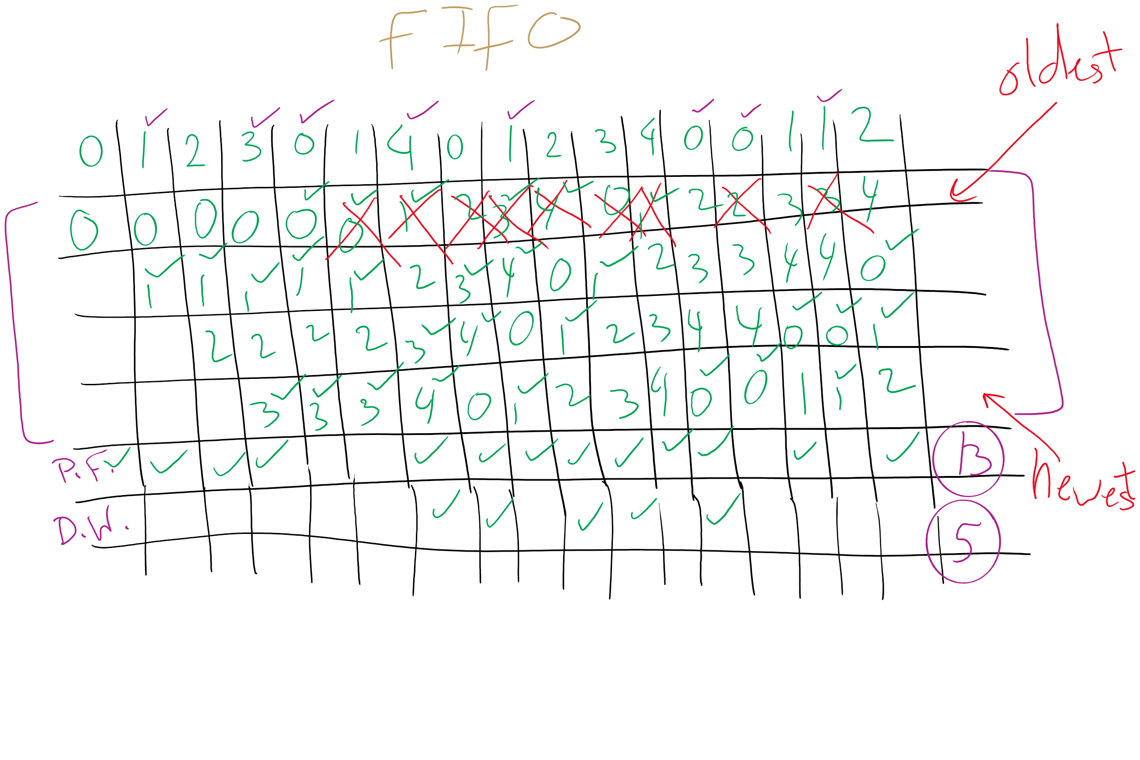
FIFO with 4 frames

Slide 16
Belady’s anomaly
Reduce the number of page faults by supplying more memory
Use previous reference string and FIFO algorithm
Add another page to physical memory (total 4 pages)
More page faults (10 vs. 9), not fewer!
This is called Belady’s anomaly
Adding more pages shouldn’t result in worse performance!
Motivated the study of paging algorithms

Slide 17
CLOCK Simulation

Slide 18
Modeling more replacement algorithms
Paging system characterized by:
Reference string of executing process
Page replacement algorithm
Number of page frames available in physical memory (m)
Model this by keeping track of all n pages referenced in array M
Top part of M has m pages in memory
Bottom part of M has n-m pages stored on disk
Page replacement occurs when page moves from top to bottom
Top and bottom parts may be rearranged without causing movement between memory and disk

Slide 19
Example: LRU
Model LRU replacement with
8 unique references in the reference string
4 pages of physical memory
Array state over time shown below
LRU treats list of pages like a stack
 | 0 | 2 | 1 | 3 | 5 | 4 | 6 | 3 | 7 | 4 | 7 | 3 | 3 | 5 | 5 | 3 | 1 | 1 | 1 | 7 | 1 | 3 | 4 | 1
 | 0 | 2 | 1 | 3 | 5 | 4 | 6 | 3 | 7 | 4 | 7 | 3 | 3 | 5 | 5 | 3 | 1 | 1 | 1 | 7 | 1 | 3 | 4 | 1
 |  | 0 | 2 | 1 | 3 | 5 | 4 | 6 | 3 | 7 | 4 | 7 | 7 | 3 | 3 | 5 | 3 | 3 | 3 | 1 | 7 | 1 | 3 | 4
 |  |  | 0 | 2 | 1 | 3 | 5 | 4 | 6 | 3 | 3 | 4 | 4 | 7 | 7 | 7 | 5 | 5 | 5 | 3 | 3 | 7 | 1 | 3
 |  |  |  | 0 | 2 | 1 | 3 | 5 | 4 | 6 | 6 | 6 | 6 | 4 | 4 | 4 | 7 | 7 | 7 | 5 | 5 | 5 | 7 | 7
 |  |  |  |  | 0 | 2 | 1 | 1 | 5 | 5 | 5 | 5 | 5 | 6 | 6 | 6 | 4 | 4 | 4 | 4 | 4 | 4 | 5 | 5
 |  |  |  |  |  | 0 | 2 | 2 | 1 | 1 | 1 | 1 | 1 | 1 | 1 | 1 | 6 | 6 | 6 | 6 | 6 | 6 | 6 | 6
 |  |  |  |  |  |  | 0 | 0 | 2 | 2 | 2 | 2 | 2 | 2 | 2 | 2 | 2 | 2 | 2 | 2 | 2 | 2 | 2 | 2
 |  |  |  |  |  |  |  |  | 0 | 0 | 0 | 0 | 0 | 0 | 0 | 0 | 0 | 0 | 0 | 0 | 0 | 0 | 0 | 0

Slide 20
Stack algorithms
LRU is an example of a stack algorithm
For stack algorithms
Any page in memory with m physical pages is also in memory with m+1 physical pages
Increasing memory size is guaranteed to reduce (or at least not increase) the number of page faults
Stack algorithms do not suffer from Belady’s anomaly
Distance of a reference == position of the page in the stack before the reference was made
Distance is ∞ if no reference had been made before
Distance depends on reference string and paging algorithm: might be different for LRU and optimal (both stack algorithms)

Slide 21
Predicting page fault rates using distance
Distance can be used to predict page fault rates
Make a single pass over the reference string to generate the distance string on-the-fly
Keep an array of counts
Entry j counts the number of times distance j occurs in the distance string
The number of page faults for a memory of size m is the sum of the counts for j>m
This can be done in a single pass!
Makes for fast simulations of page replacement algorithms
This is why virtual memory theorists like stack algorithms!

Slide 22
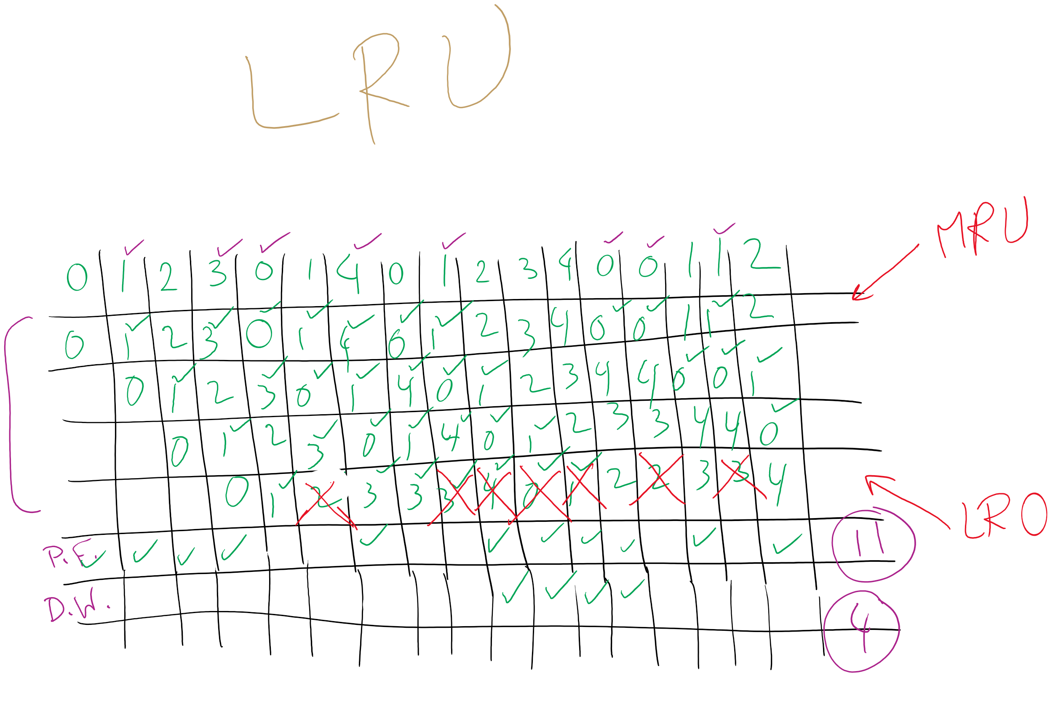
LRU

Slide 23
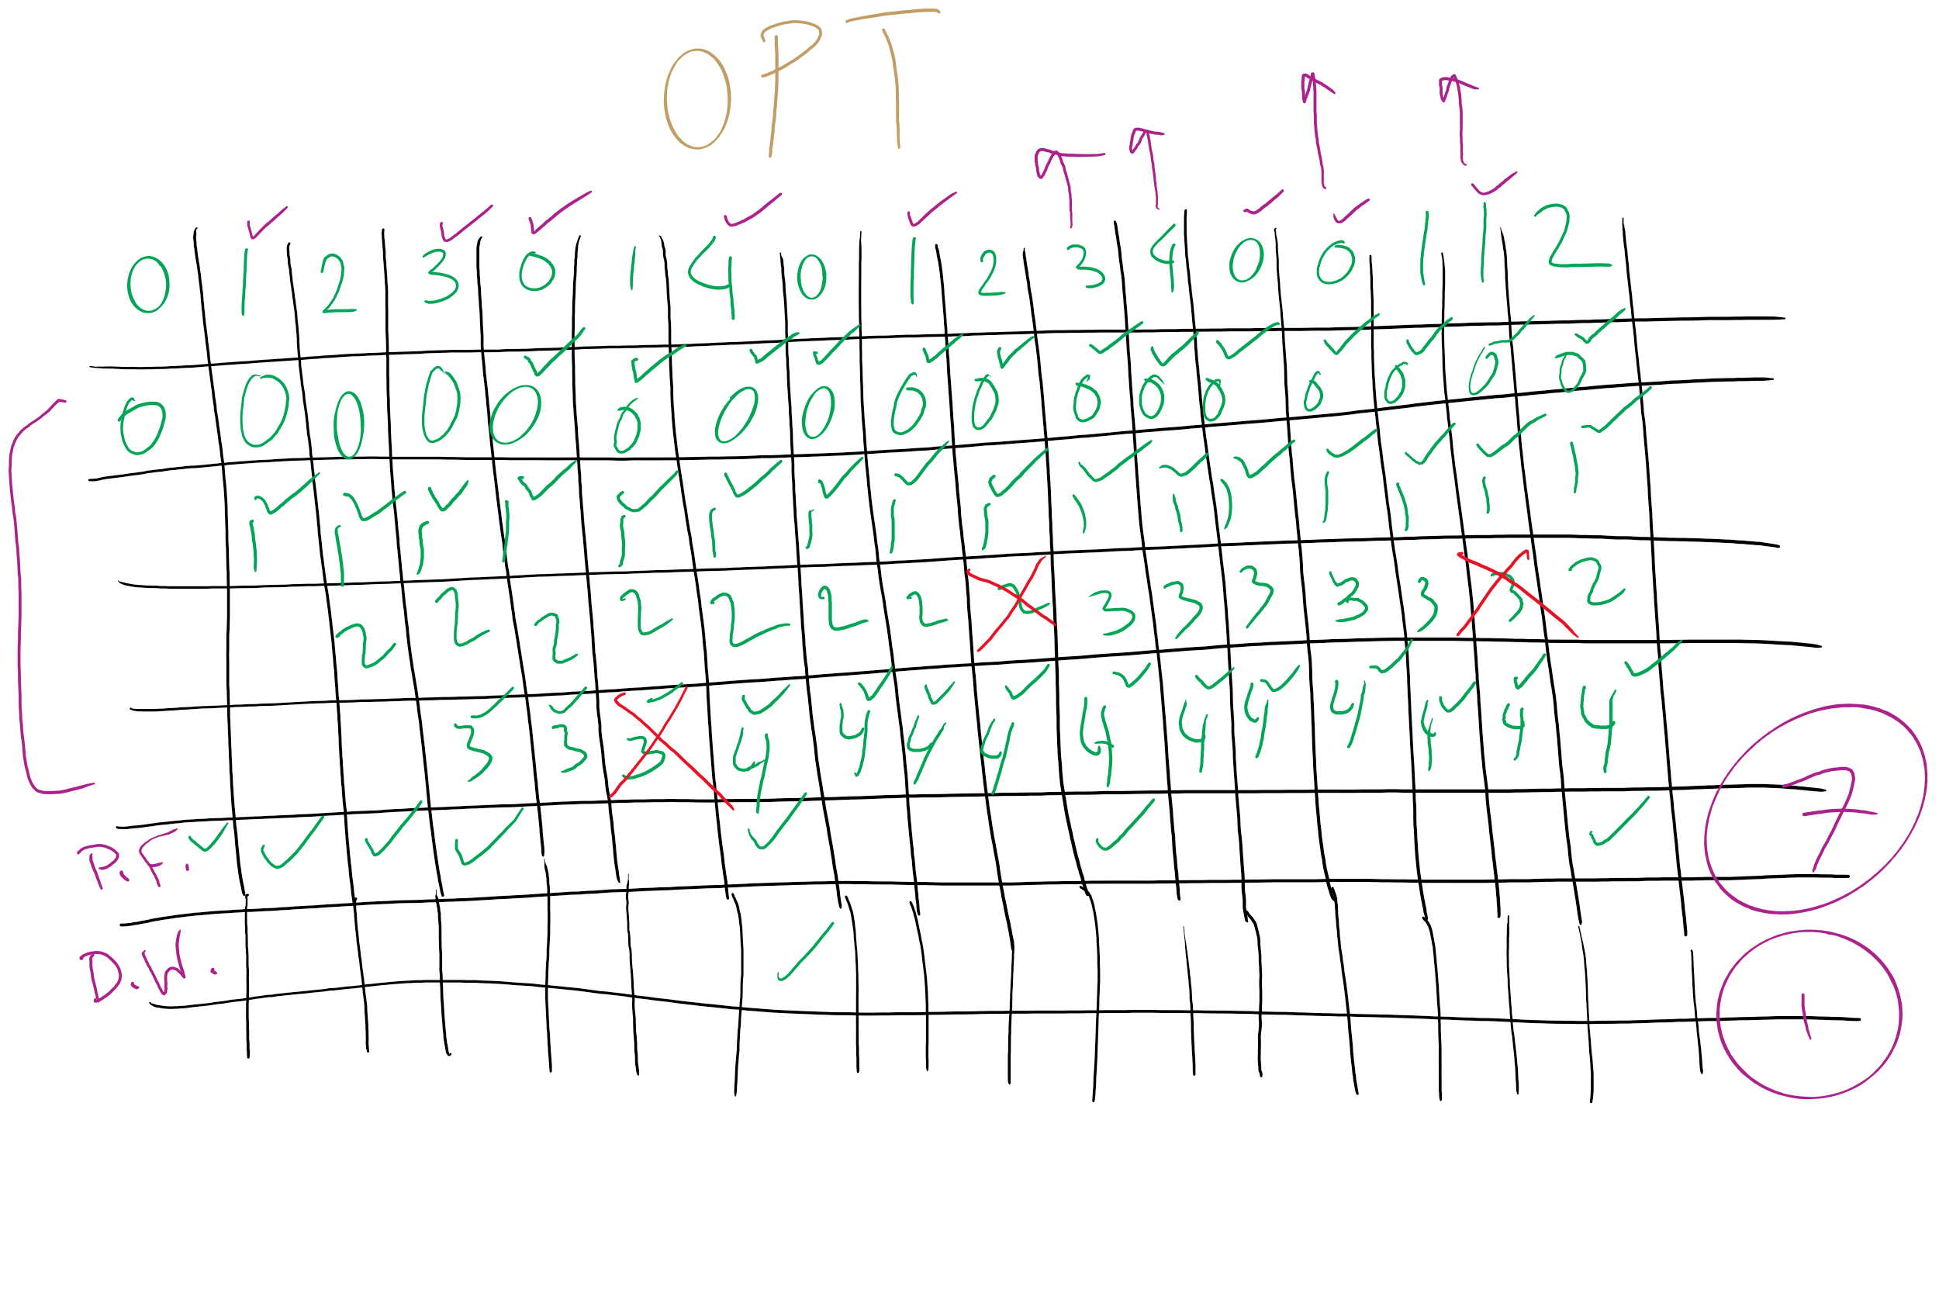
OPT

Slide 24
Local vs. global allocation policies
What is the pool of pages eligible to be replaced?
Pages belonging to the process needing a new page
All pages in the system
Local allocation: replace a page from this process
May be more “fair”: penalize processes that replace many pages
Can lead to poor performance: some processes need more pages than others
Global allocation: replace a page from any process
Last access time
Page
A0
14
A1
12
Local allocation
A2
8
A3
A4
5
A4
B0
10
B1
9
Global allocation
B2
A4
3
C0
16
C1
12
C2
8
C3
5
C4
4

Slide 25
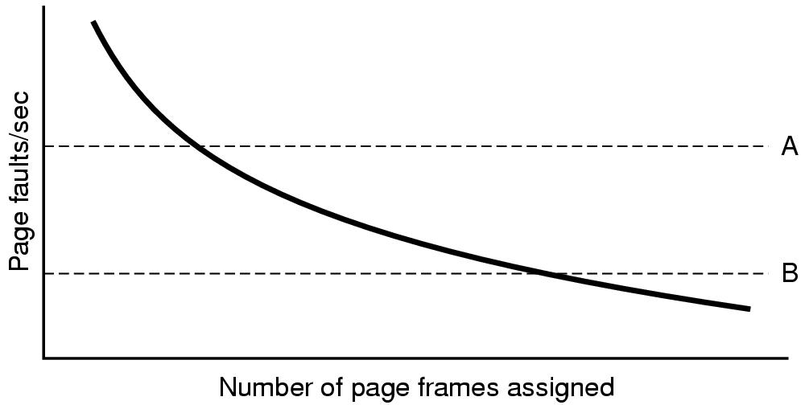
Page fault rate vs. allocated frames
Local allocation may be more “fair”
Don’t penalize other processes for high page fault rate
Global allocation is better for overall system performance
Take page frames from processes that don’t need them as much
Reduce the overall page fault rate (even though rate for a single process may go up)

Slide 26
Control overall page fault rate
Despite good designs, system may still thrash
Most (or all) processes have high page fault rate
Some processes need more memory, …
but no processes need less memory (and could give some up)
Problem: no way to reduce page fault rate
Solution : Reduce number of processes competing for memory
Swap one or more to disk, divide up pages they held
Reconsider degree of multiprogramming

Slide 27
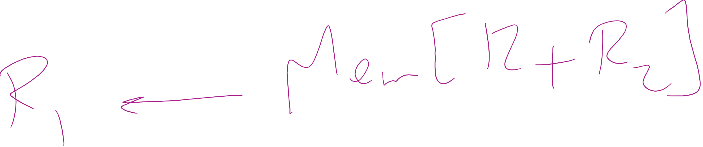
Backing up an instruction
Problem: page fault happens in the middle of instruction execution
Some changes may have already happened
Others may be waiting for VM to be fixed
Solution: undo all of the changes made by the instruction
Restart instruction from the beginning
This is easier on some architectures than others
Example: LW R1, 12(R2)
Page fault in fetching instruction: nothing to undo
Page fault in getting value at 12(R2): restart instruction

Slide 28
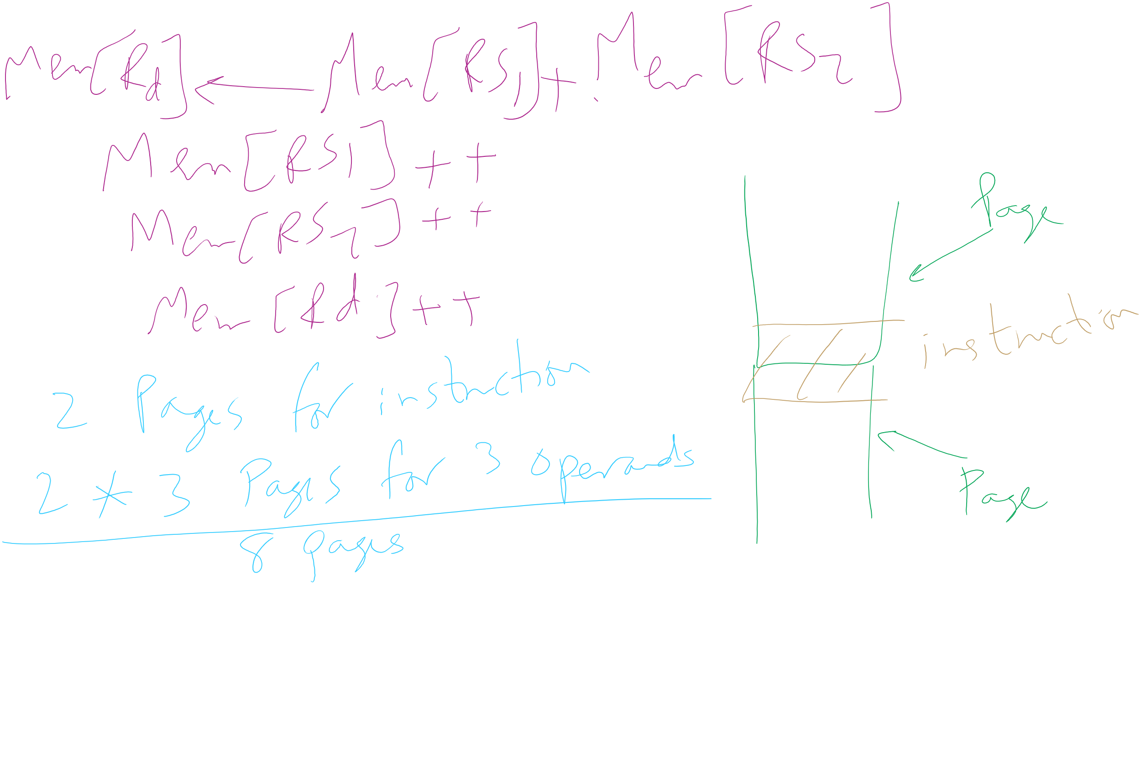
Minimum memory allocation to a process
Example: ADD (Rd)+,(Rs1)+,(Rs2)+
Page fault in writing to (Rd): may have to undo an awful lot…

Slide 29
Separating policy and mechanism
Mechanism for page replacement has to be in kernel
Modifying page tables
Reading and writing page table entries
Policy for deciding which pages to replace could be in user space
More flexibility
3. Request page
User process
External pager
4. Page arrives
User space
2. Page needed
5. Here is page!
Kernel space
Fault handler
MMU handler
1. Page fault
6. Map in page

Slide 30
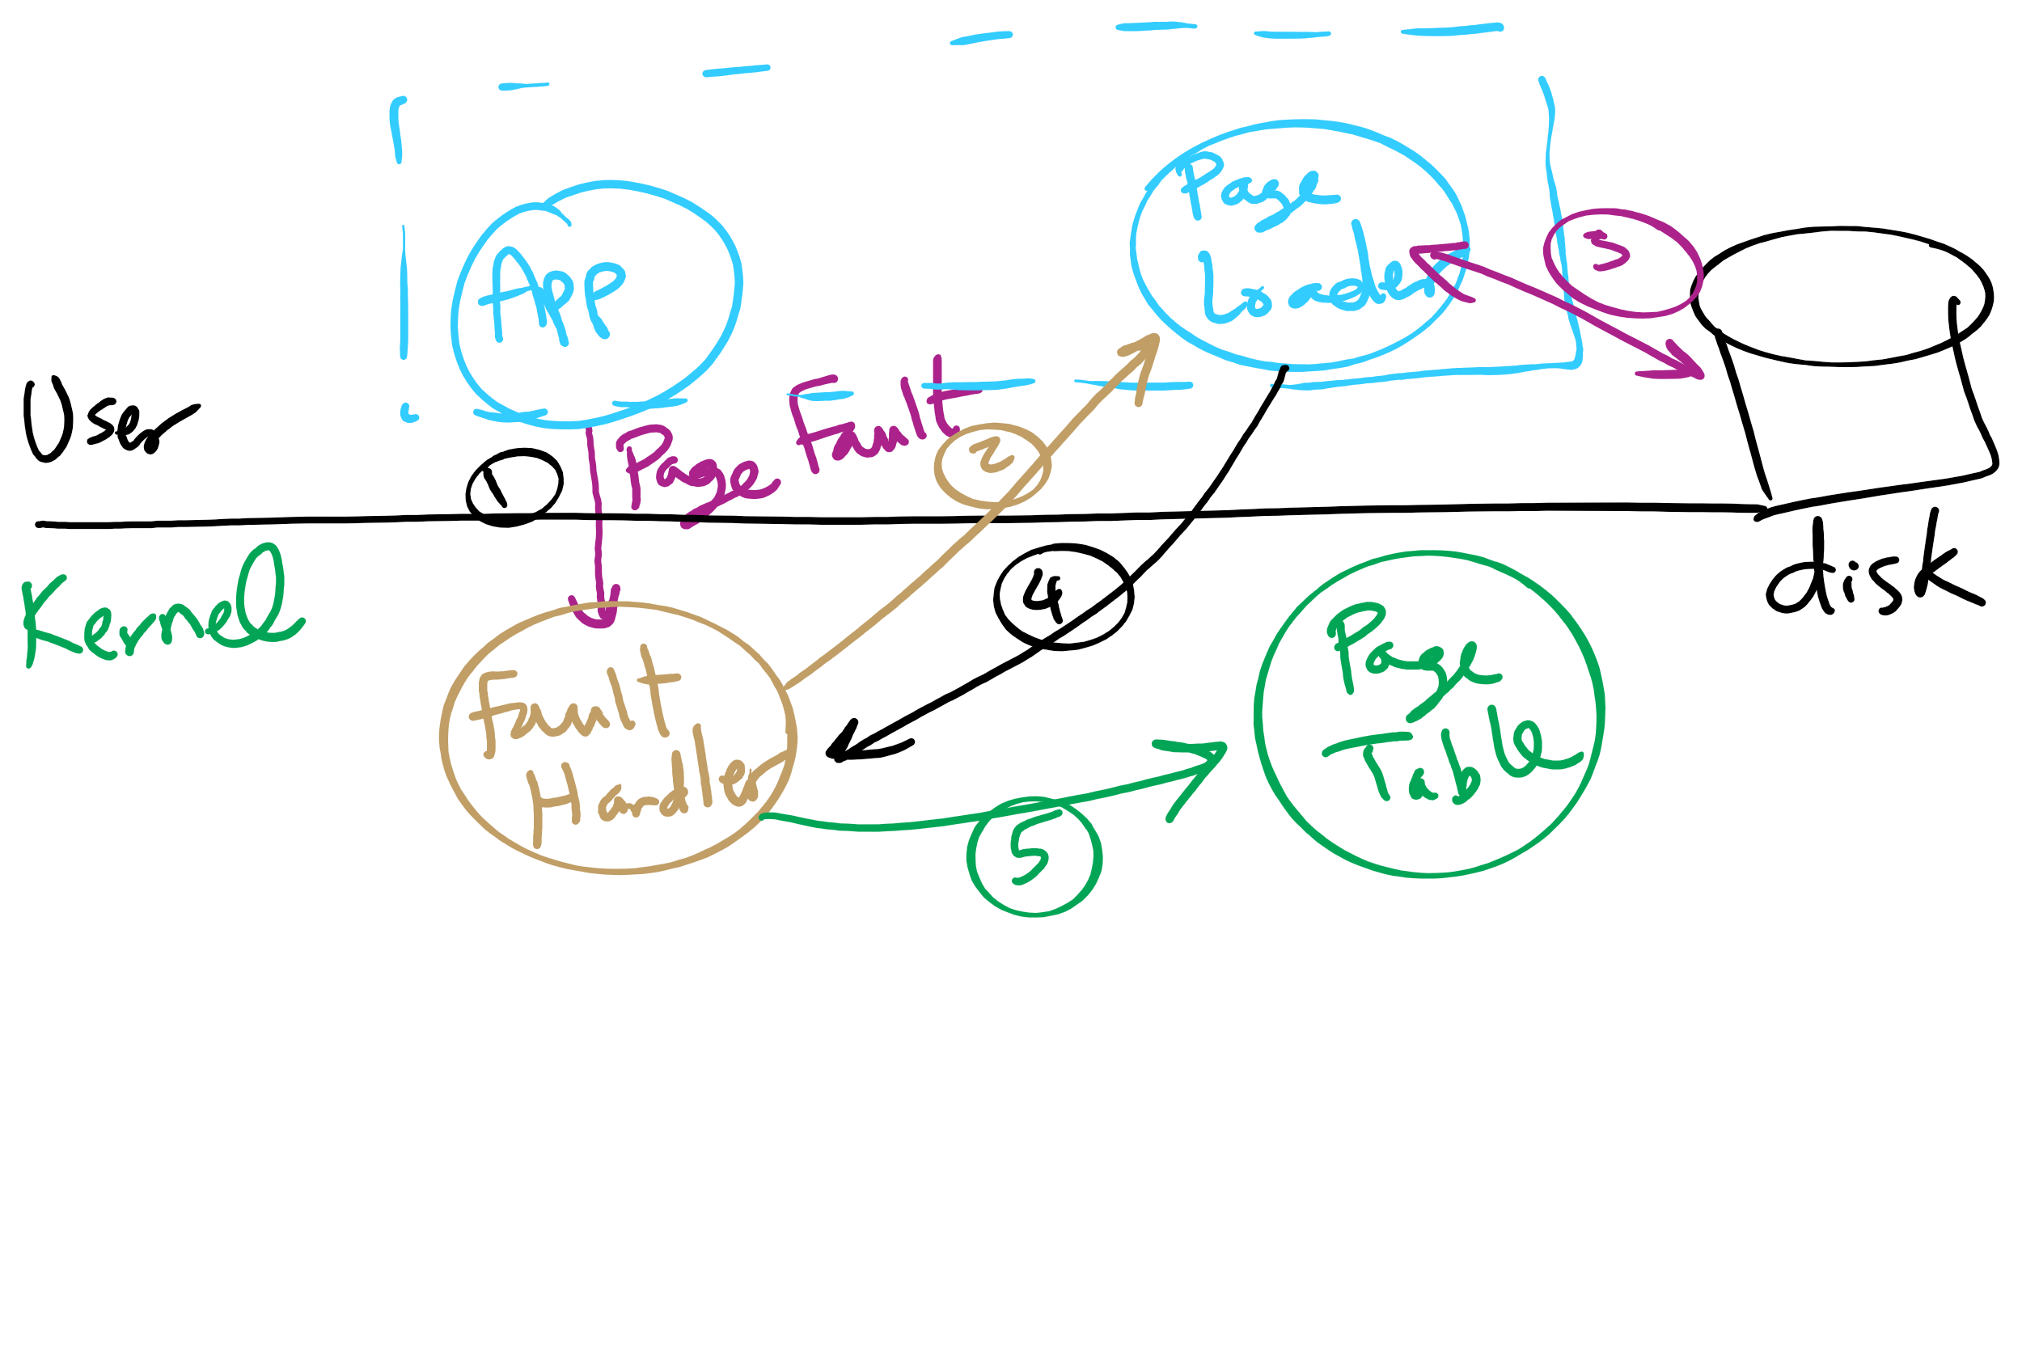
Separating Policy and Mechanism for Page Replacement

Slide 31
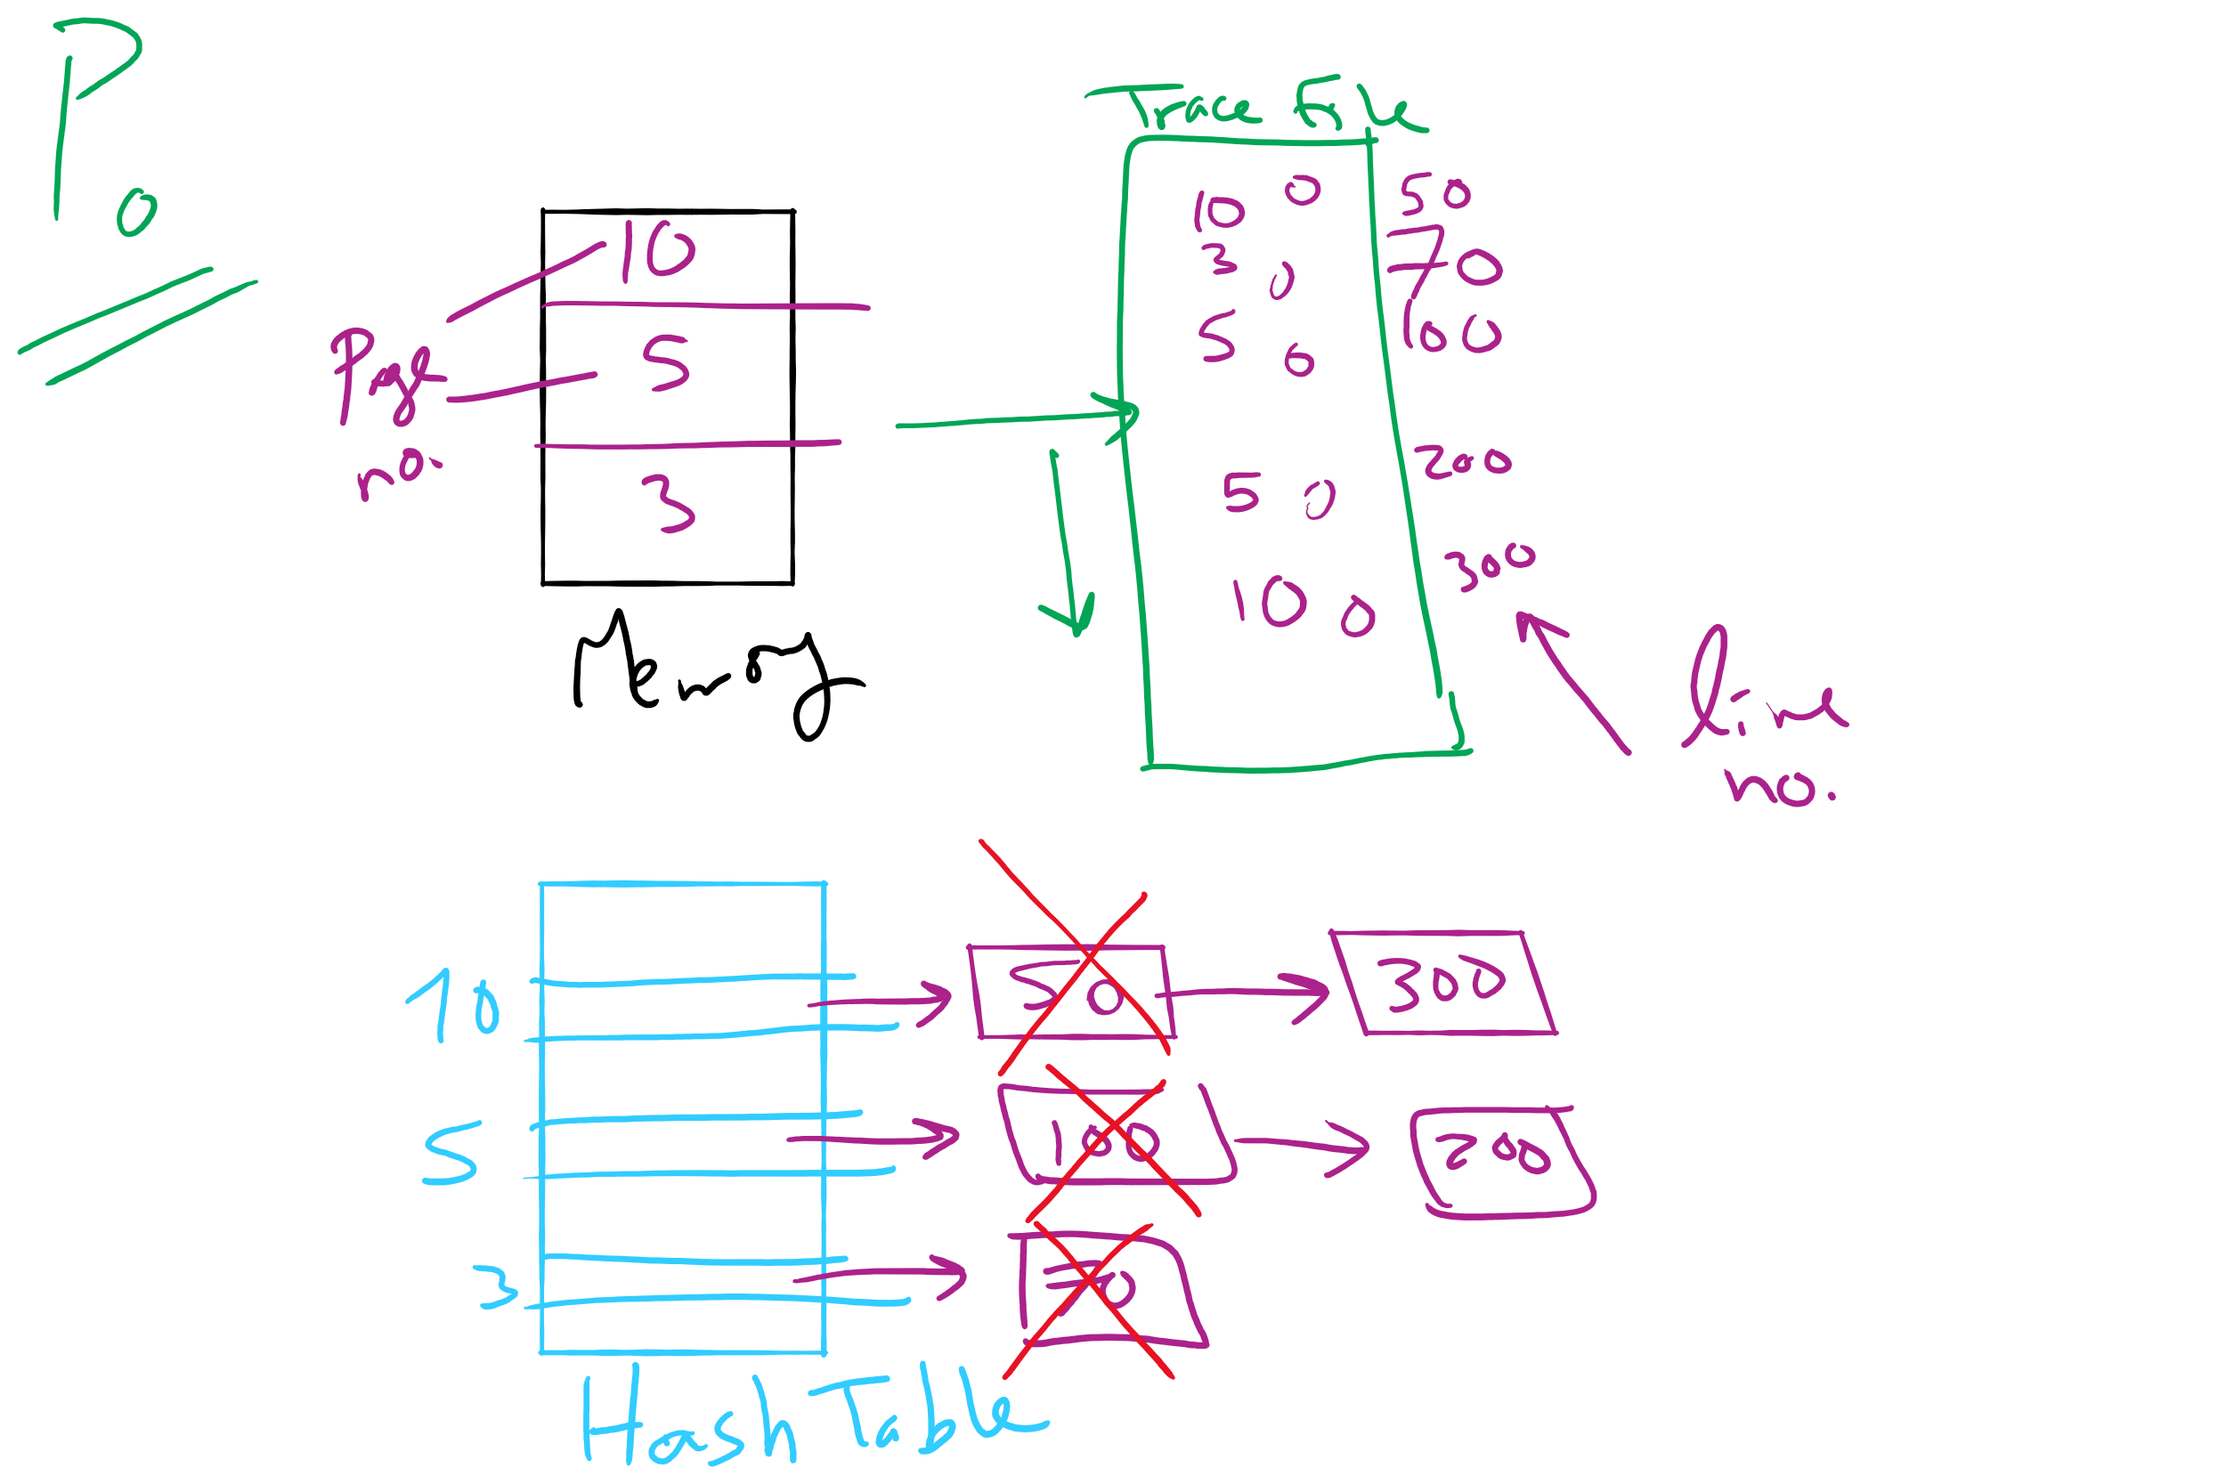
Project 3: OPT Simulation

Slide 32
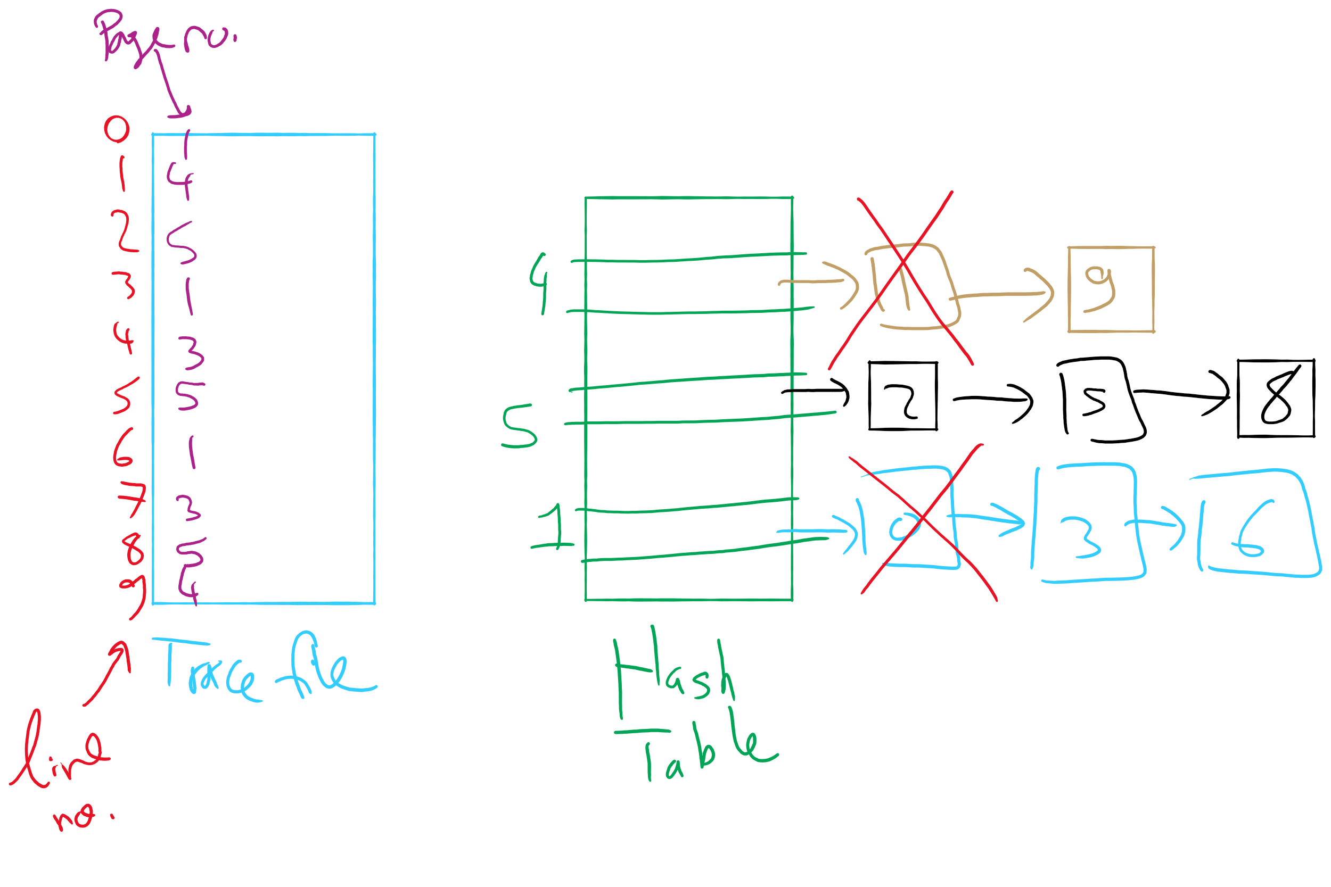
OPT Implementation Example

Slide 33

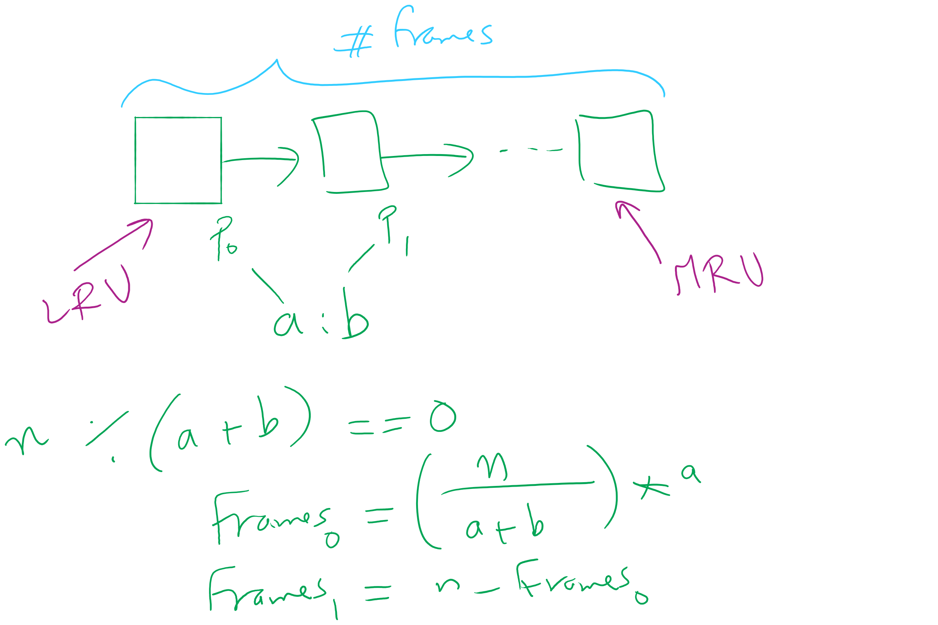
Project 3: LRU and miscellaneous hints

Slide 34
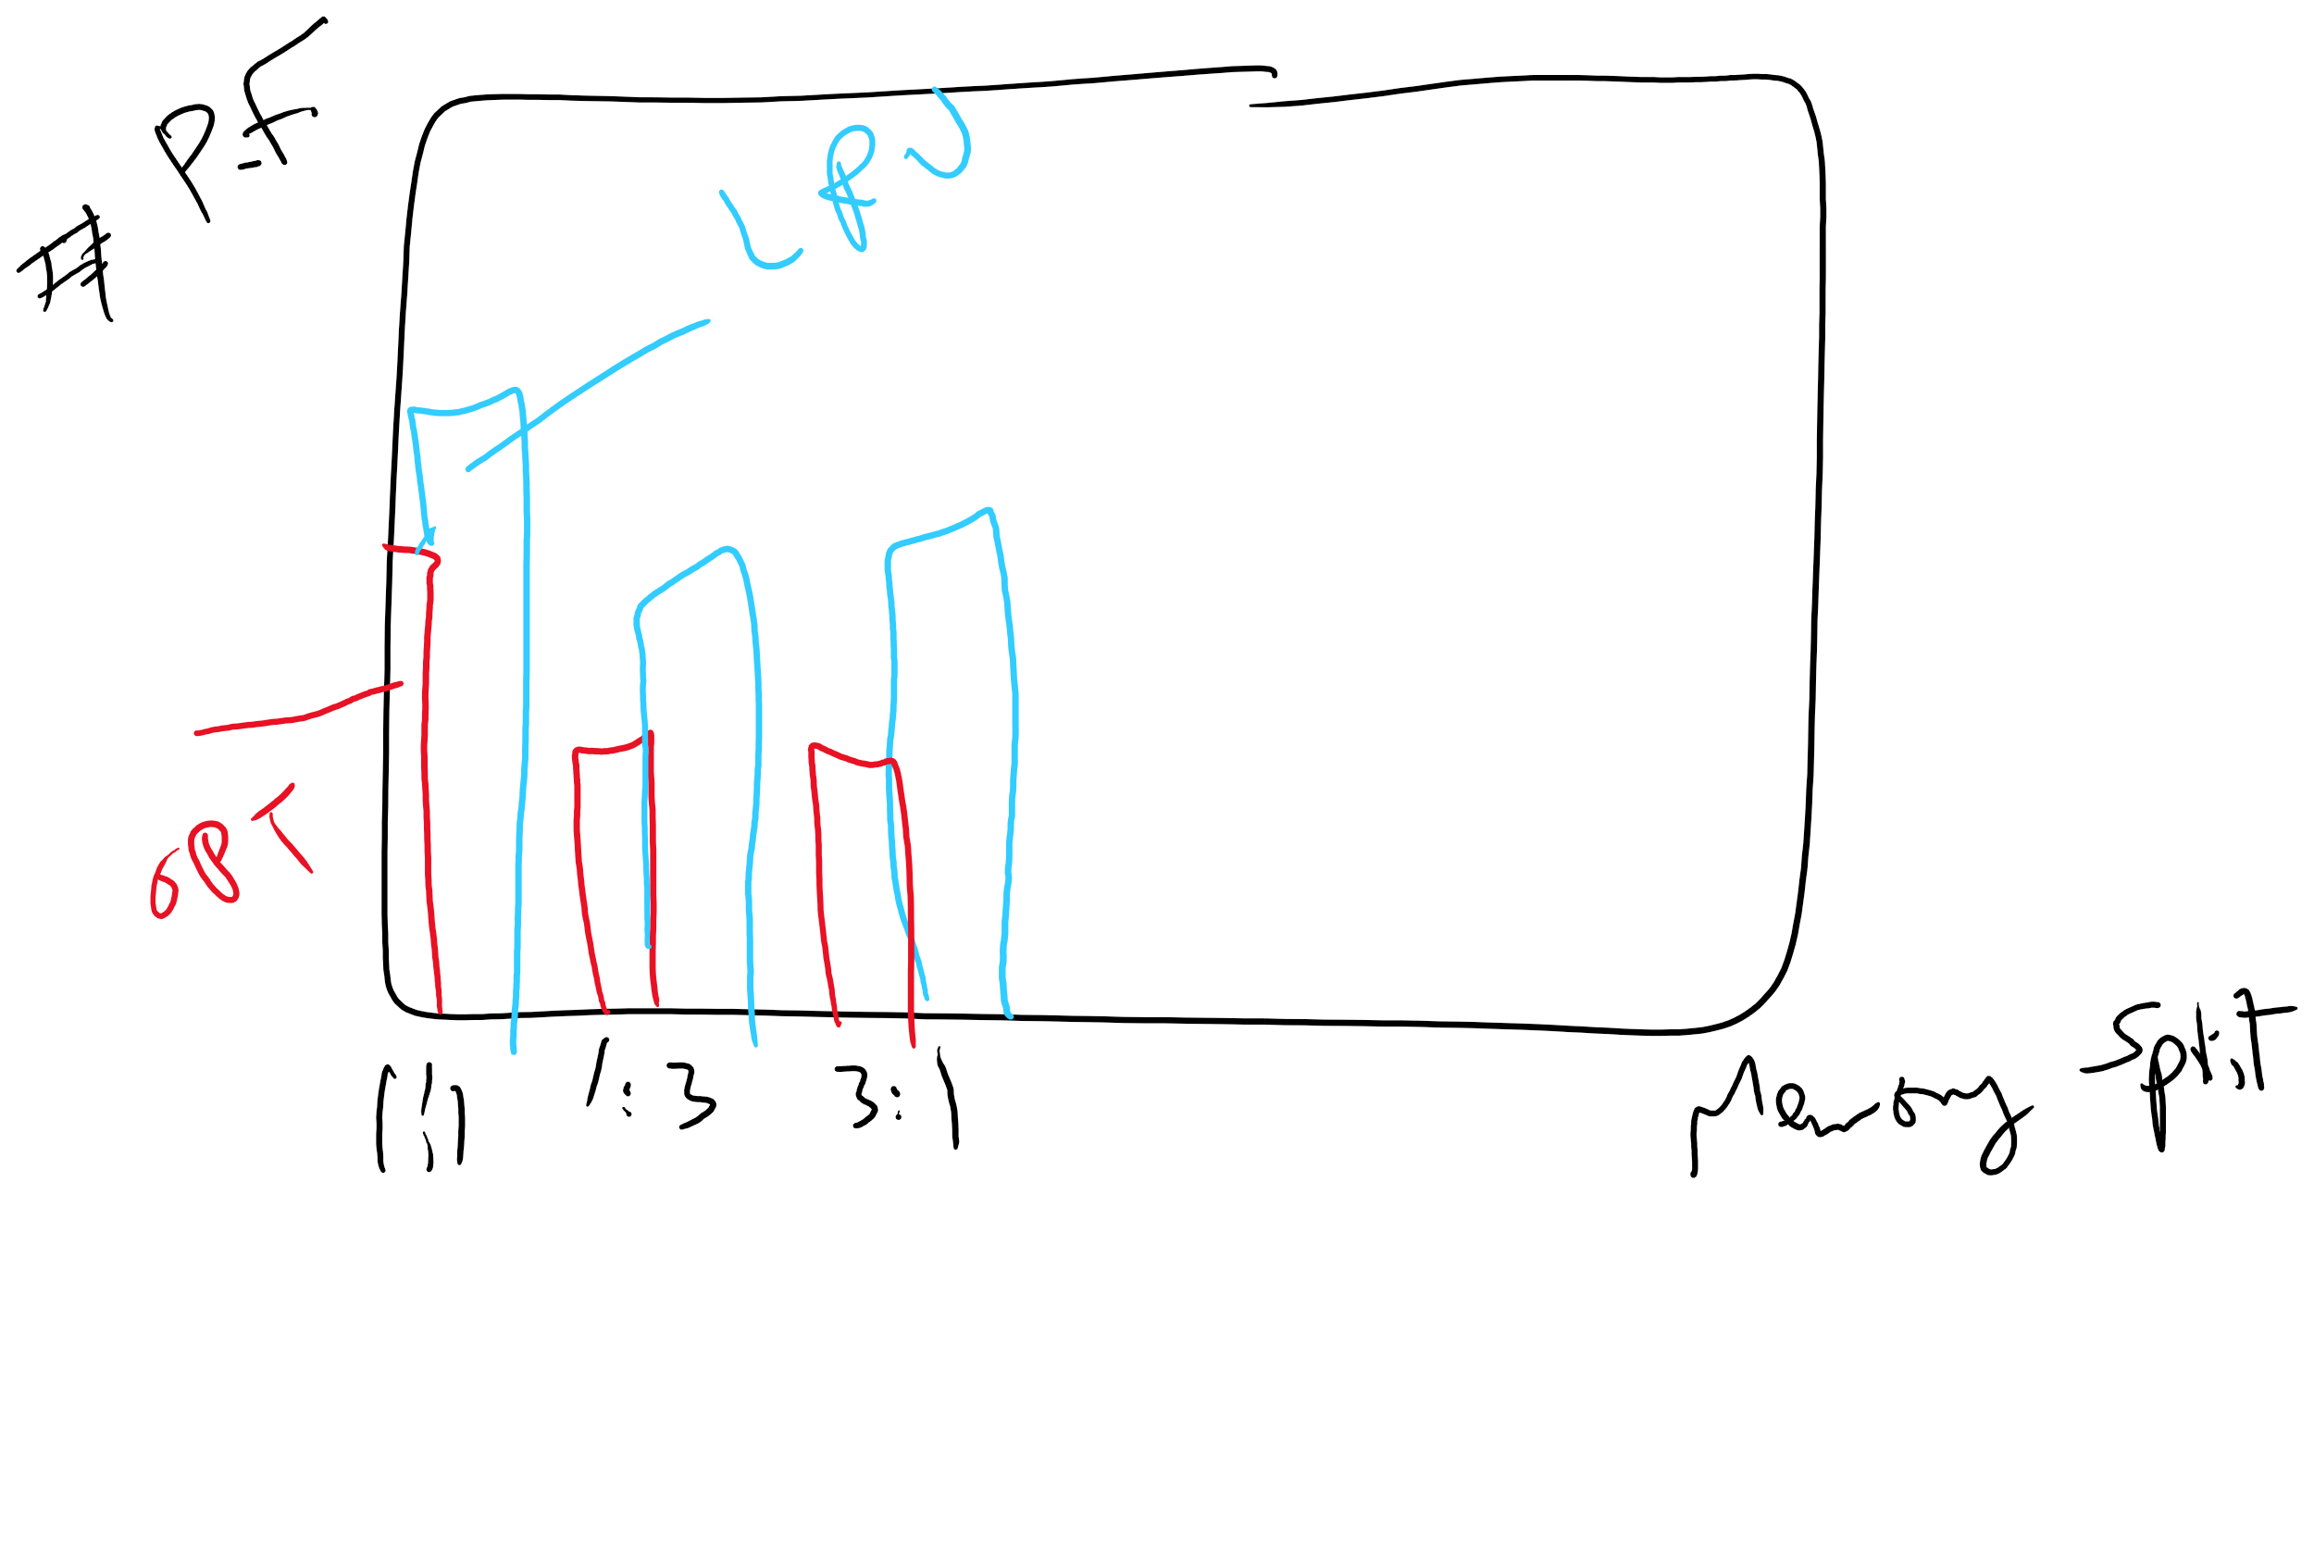
Project 3: Writeup hints

